Slide 1
GUI Development
Does it need to work across platforms or is Windows compatibility fine?
Newest Application Development option for Windows called WinUI 3
Supports lots of features
Worked with WinForms before but – old and outdated
Worth actually making a mock up?

Slide 2


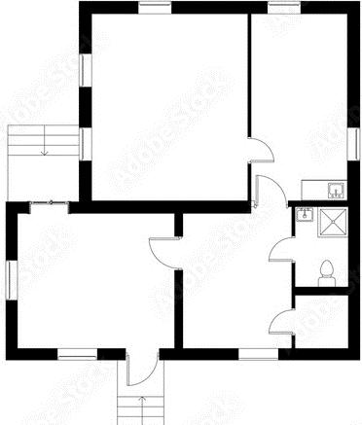
Main Form
Floors
Rooms
Ground Floor
Ground Floor
First Floor
Second Floor
Attic
Entrance Hall
Living Room
Kitchen
Bedroom 1
Kitchen
Living
Room
Entrance
Hall
Bedroom 1

Slide 3
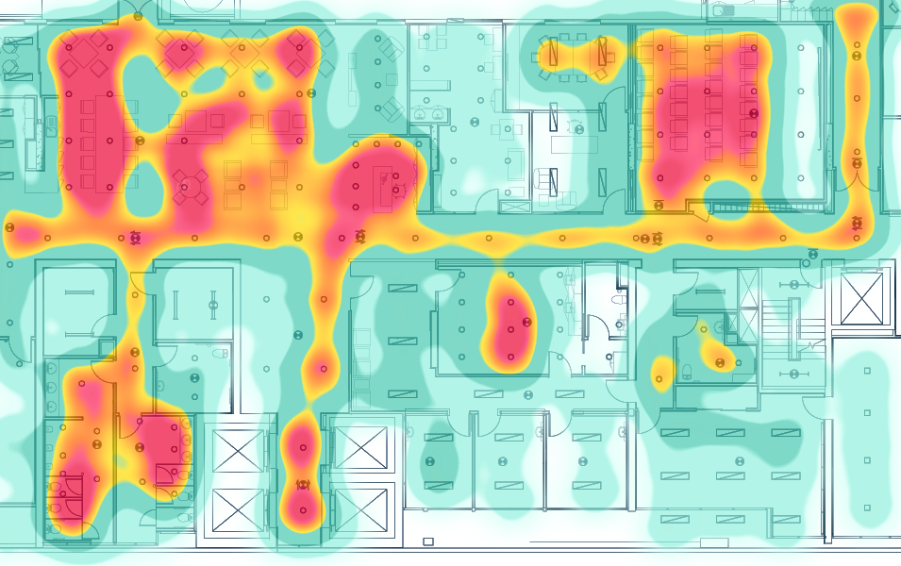
Individual Room Form
Floors
Rooms
Options
Overview
Ground Floor
First Floor
Second Floor
Attic
Entrance Hall
Living Room
Kitchen
Bedroom 1
Live Force Map
Heat Map
Alert History
Gait Analysis Data?
Last Fall Alert – 12:45:56 23/04/2022
Last Motion Detected – 12:45:56 28/04/2022
Last 24 hours heatmap:

Slide 4
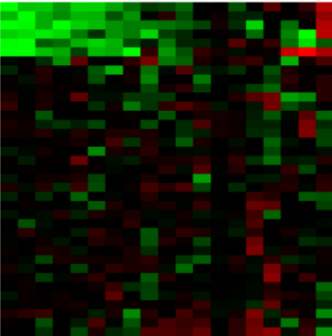

Live Force Map
Heat Map
- Near Max. Force
Last hour
Last 24 hours
Last week
Last Month
Since installation
- Near Min. Force
- No Measurable Force
(Drop down
menu above)
(Shows whole floor but our
one would just show one room)

Slide 5
Alert History
Gait Analysis Data
Alert Time | Alert Type | Time to Response | False Alarm?
23:45:32 12/03/2022 | Fall | 00:02:34 | N
05:45:32 23/01/2022 | Fall | 00:01:44 | Y
15:45:32 17/08/2021 | Sensor Malfunction?? | 00:05:04 | Y
21:35:32 10/05/2021 | Fall | 00:00:39 | N
20:43:42 26/02/2021 | Fall | 00:02:13 | N
Select Person
Average step force | ??
Steps per minute | ??
Average stride length | ??
Time Spent standing | ??

